Slide 1
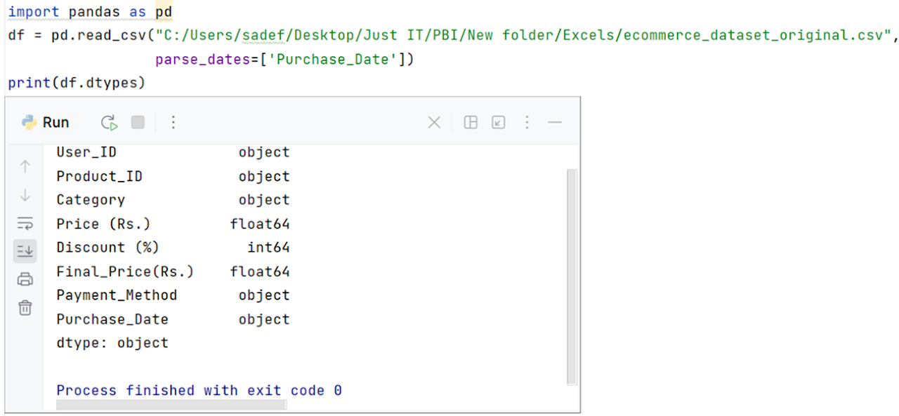
Importing pandas
Importing the csv of the e-commerce dataset
Checking the data types of the columns for any potential issues

Slide 2
There's an Issue! Data type "Purchase_Date" is being read as an object, not a date. This will produce issues with code and eventually visuals if not converted correctly.
I will explain the code I used to resolve this:
parse_dates=['Purchase_Date'] - used while reading the csv, initial conversion from object (string) to datetime
(df['Purchase_Date') - places this column into a Pandas DataFrame
pd.to_datetime() - functions as a double check, to ensure all dates are converted to datetime date type
'%d/%m/%Y' - specifies the format of the values within the column
errors = 'coerce' - if a value cannot be converted, return "NaT" (Not a Time), a missing or invalid datetime value. The remaining code is to produce the output, allowing us to check if our code was successful in converting all dates, as well as saving it as a new csv file.

Slide 3
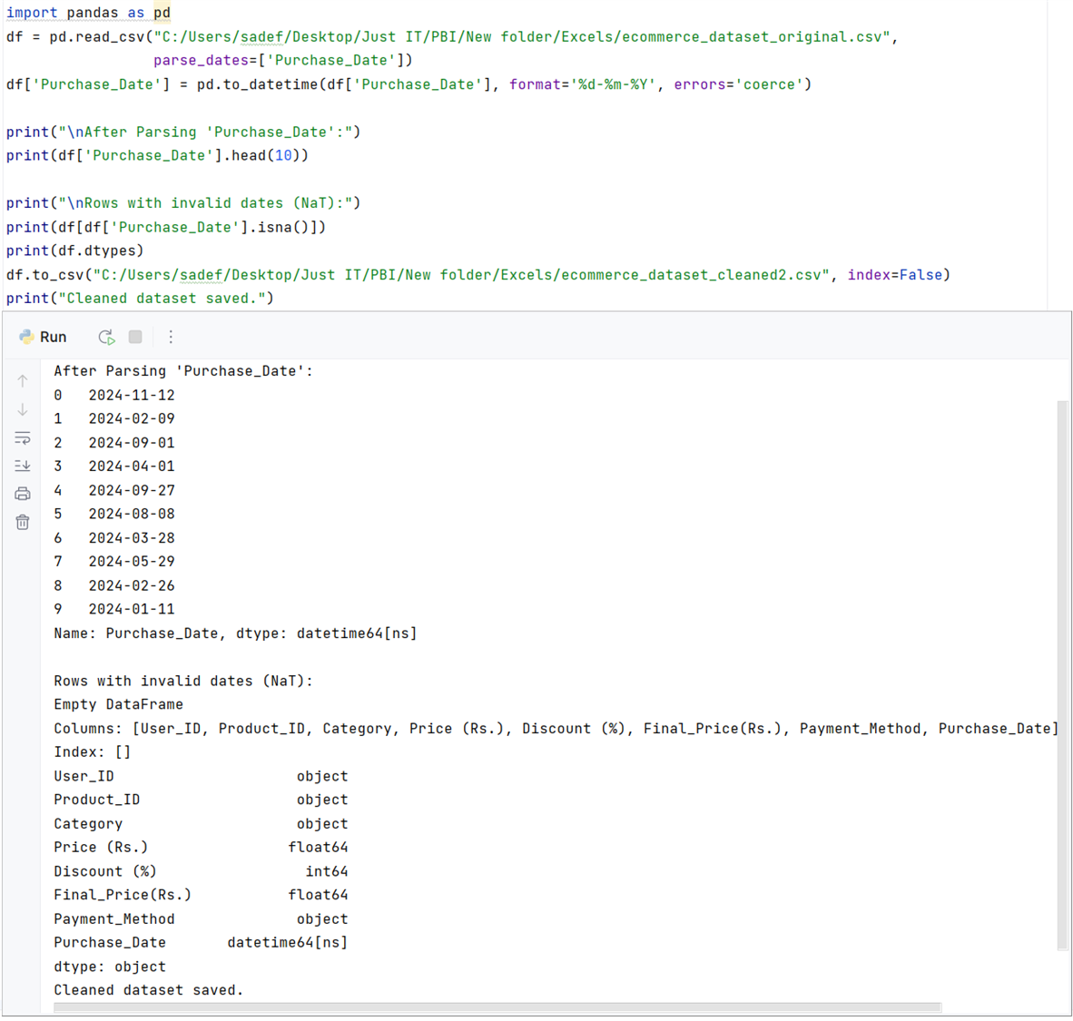
We run a final check to see if the data is clean.
parse_dates - ensuring that while it reads the data file, 'Purchase_date' is understood as datetime (to prevent misinterpretation)
print(f"Shape of Dataframe: {df.shape}") - returns a list of the column names in the data frame
Output: Are there any Null values in these columns?
Output: Are there duplicate rows, if so, how many?

